Slide 1
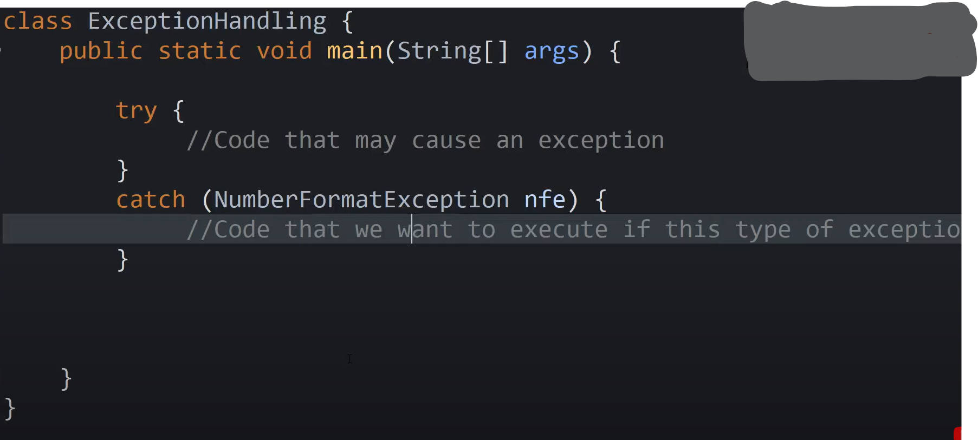

Slide 2
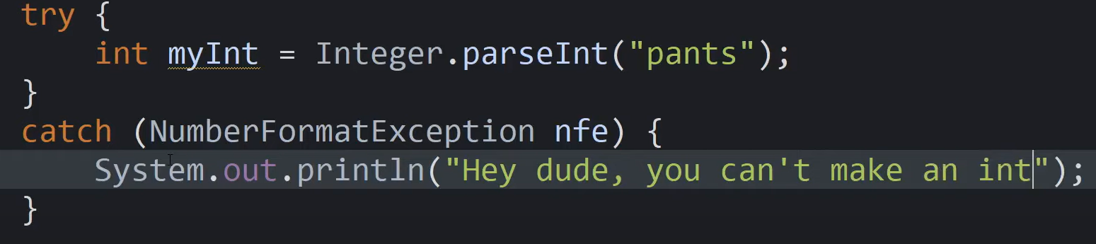
If exception is not thrown this catch block will never be executed

Slide 3
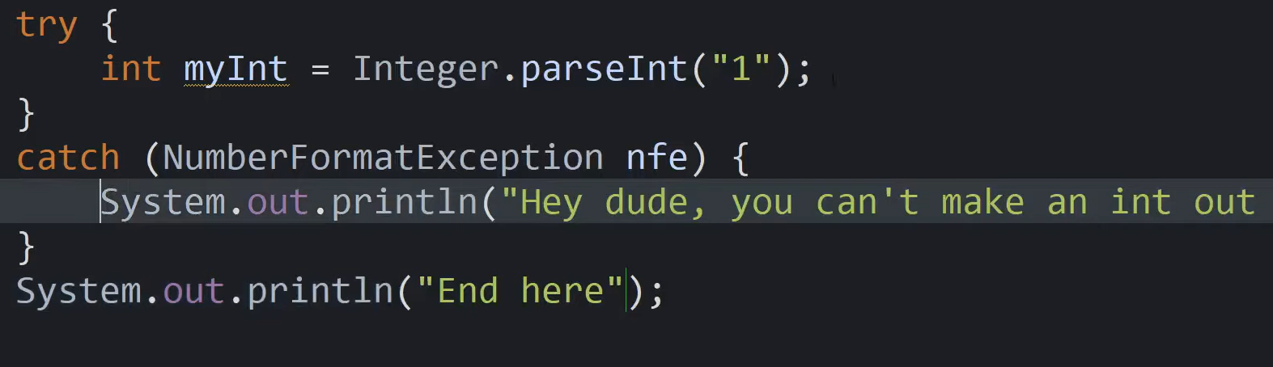

Slide 4
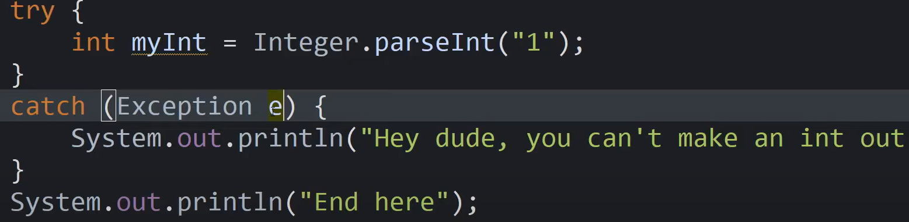
Exception Hierarchy

Slide 5
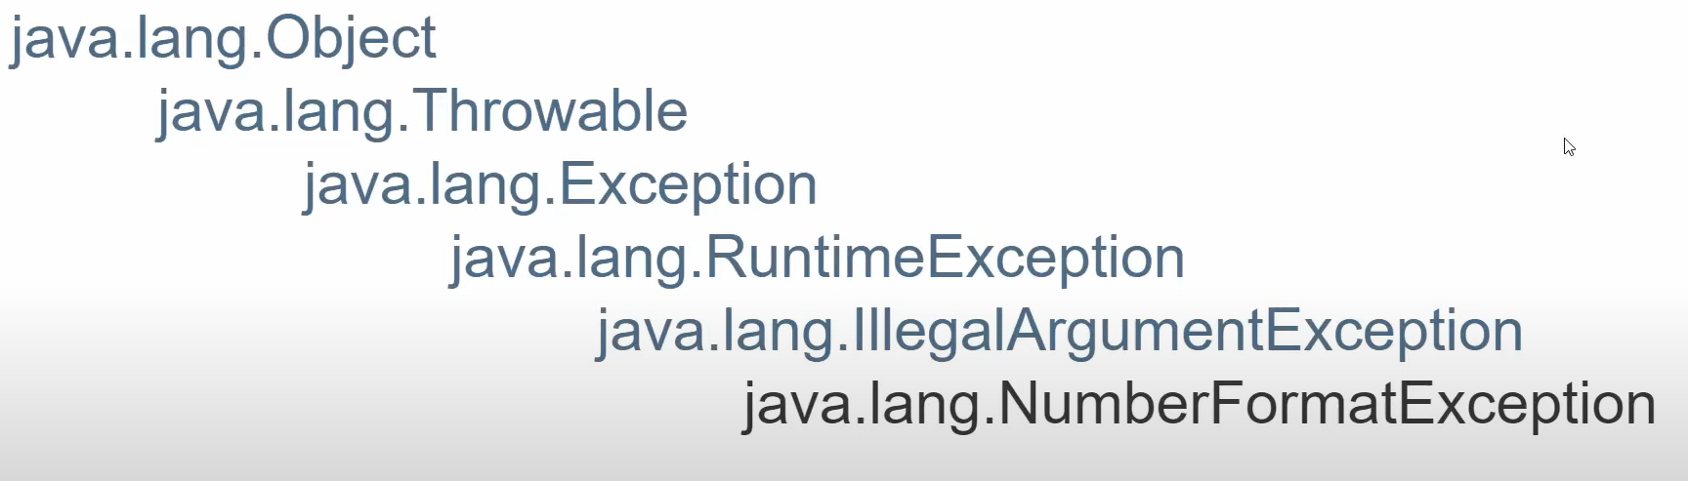
2 types of throwables: Exceptions and errors and trying to catch errors causes unidentified behavior

Slide 6
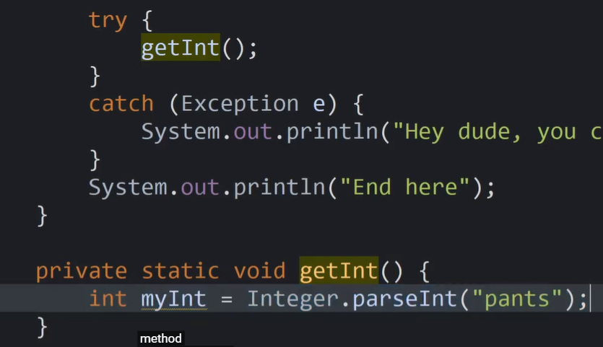
In programs you don't necessarily need to catch your exception right at the exact line that it happens when an exception gets thrown and it's not caught immediately in the method that it's in right then it'll get thrown up to the method that called it that's called the call stack throw an exception goes up the call stack until it is caught by a catch statement

Slide 7
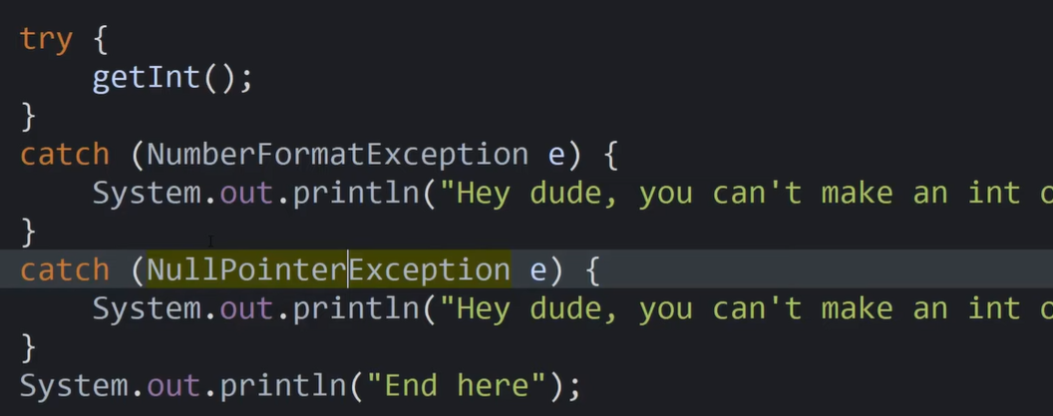
you can catch multiple types of exceptions with multiple catch blocks

Slide 8
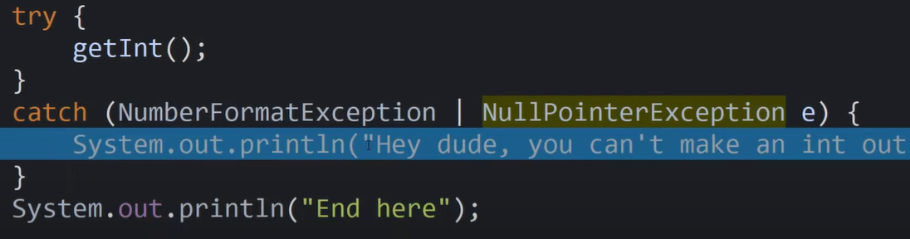
Multi catch statements to avoid code duplication while still being able to catch multiple types of exceptions

Slide 9
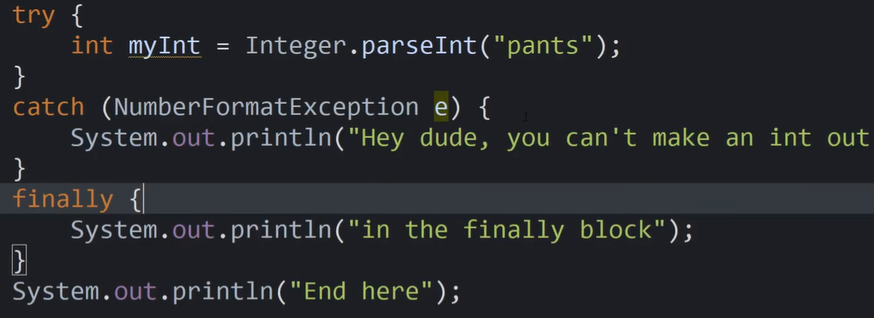
Finally blocks: after catch and it always executes whether there was an exception or not

Slide 10
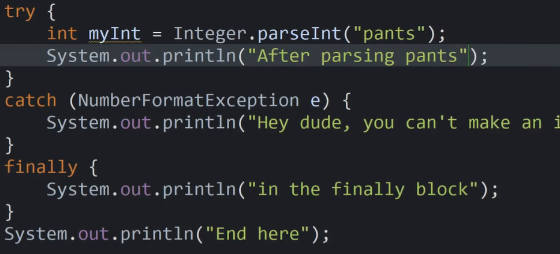
When an exception is thrown the rest of the code after that will not be executed

Slide 11
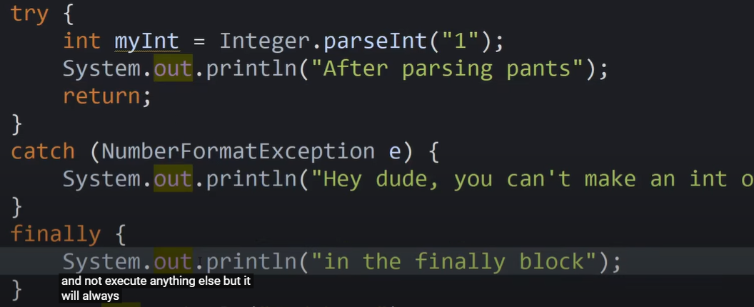
Finally executes the finally even if no exception is thrown and even if we return in try

Slide 12
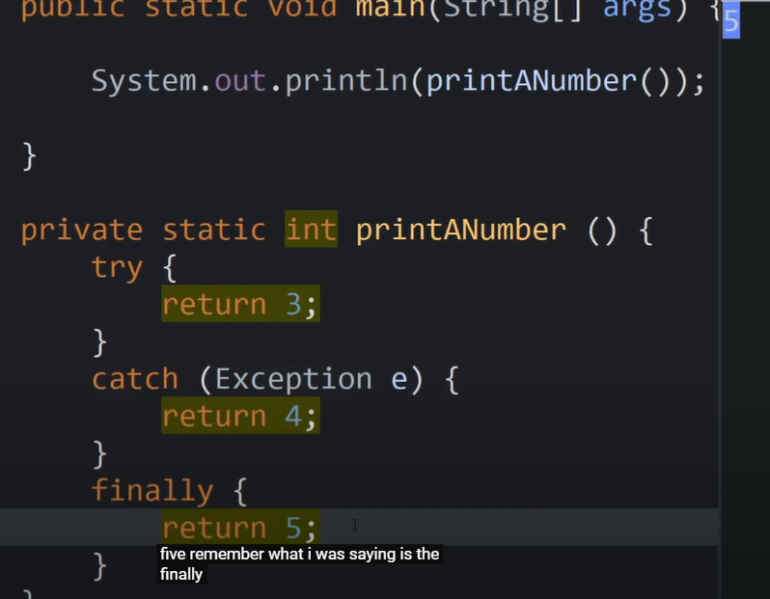
a return statement in your finally will override a return statement in your try or your catch blocks, generally just avoid it and it's

Slide 13
You use finally when you want to close your connection like to the database or to the file stream because that's something you would always want to do or to just free resources

